Slide 1
Enterprise Curer
Sprint 6 Planning Meeting
Product Owner: Xiao Zhou
Scrum Master : Hongyuan Li
Team Member: Si Feng
Notes:
大家好，我们是music tag小组.我们做的项目是一个音乐百科网站。我是张时乐，来自复旦大学软件学院，研究生在读，在本次project中担任Product Owner的角色。…

Slide 2
Agenda
Project background
Project process
Project planning
Q & A
Notes:
这是我们本次项目展示的流程。首先，我们会对的项目进行一个基本介绍，然后通过demo的形式展示项目的核心feature，接下来会从技术方面，讲解我们项目的整体架构，以及在技术选择上的思考和权衡。然后是每个人对所做工作的汇报，最后是Q&A环节。

Slide 3
Enterprise Curer
Business description
What!
Why?
How…

Slide 4
Business Description
History data survey
Crawl Data from confluence
Data pre-process
Solution Investigation

Slide 5
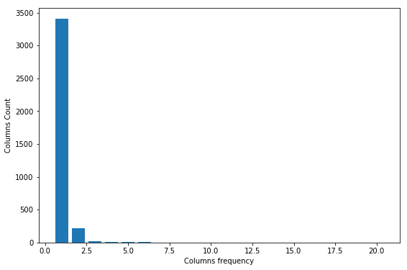
History data survey
Done
Initial idea:
Mining frequency pattern of relationship between radd columns and descriptions
Survey result:
The amount of history data is not enough.
It is not suitable for frequency pattern mining

Slide 6
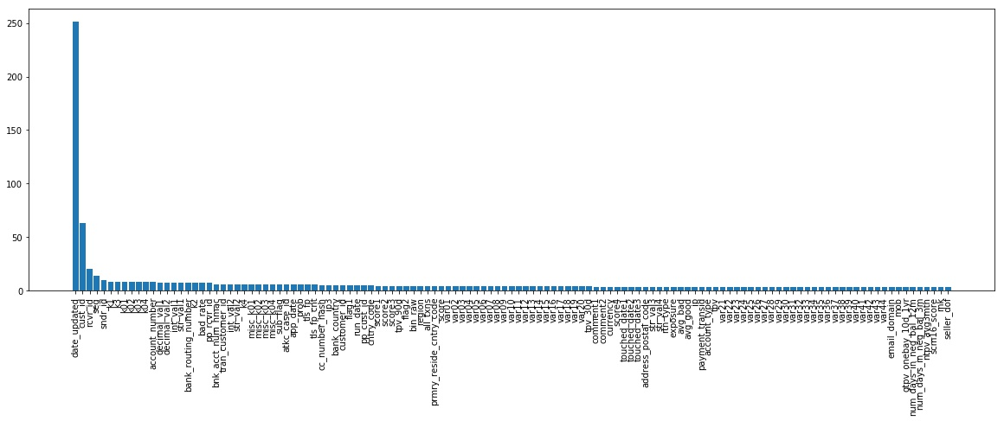
History data survey
Column-Frequency Table

Slide 7
Crawl
Done
Pages
Volume: 200M
Time:
Target: Fetch data from confluence as corpus input
Problems: Authentication
Solution: Use cookies to access pages
Tools: Scrapy, Pycharm

Slide 8
Data Pre-process
Original: 359M
Stage 2: 8.3M
Stage 1: 14.4M
In progress
Target: Parse HTML structure and extract content
Solution: Use regular expression to extract the content
Tool: Beautifulsoap, re lib

Slide 9
Solution Investigation
LDA
LSA
Word2Vec
TF-IDF
In progess
Target: Validate the meaningful degree of business description
Problem: Hard to define the meaningful degree of a short sentence
Solution: Investigate three different models to extract the keywords of the sentence and give a score for it.
Tool: gensim lib

Slide 10
Next Step
Build a model based on TF-IDF to score business description
Provide an external API for business description validation

Slide 12
Q & A

